Slide 1

Breakout

Slide 2
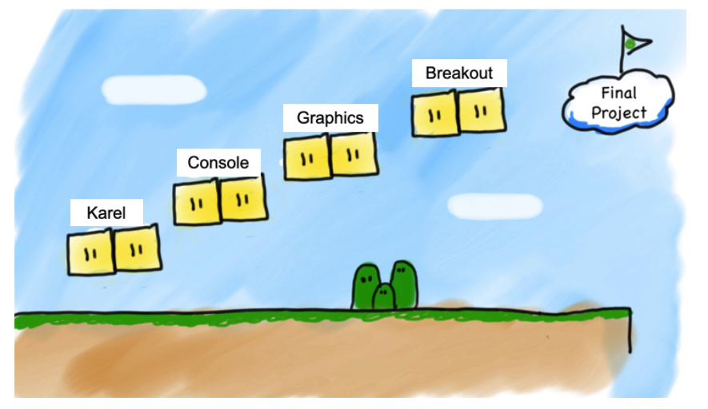

Slide 3
Today’s topics
Review
Mouse
Breakout Requirements
Stages in development

Slide 4
Mouse Event
At any time, we can ask the canvas for
the current location of the mouse
mouse_x = canvas.get_mouse_x()
mouse_y = canvas.get_mouse_y()
the clicks of the mouse
clicks = canvas.get_new_mouse_clicks()

Slide 5
Handle Mouse Events
Ask to canvas for mouse location and handle it events
If there are, then we do something.
If there are not, we do nothing and check again later.
while True:
# Handle any new mouse events
# ...
canvas.update()

Slide 6
Handle Mouse Movement
Ask to canvas for mouse location and handle it
If there are, then we do something.
If there are not, we do nothing and check again later.
while True:
# get mouse location
mouse_x = canvas.get_mouse_x()
mouse_y = canvas.get_mouse_y()
# do_something
DO_SOMETHING()
# update canvas
canvas.update()

Slide 7
Doodler
SQUARE_SIZE = 10
...
while True:
# Get the mouse location
mouse_x = canvas.get_mouse_x()
mouse_y = canvas.get_mouse_y()
# do_something
# Create a black rectangle at this location
rect = canvas.create_rectangle(mouse_x, mouse_y,
mouse_x + SQUARE_SIZE,
mouse_y + SQUARE_SIZE)
canvas.set_color(rect, 'black')
# update canvas
canvas.update()
Notes:
Let’s step through

Slide 8
Handle Mouse Clicks
Ask to canvas for mouse click and handle it
If there are, then we do something.
If there are not, we do nothing and check again later.
while True:
clicks = canvas.get_new_mouse_clicks()
# each time the user clicks do something
for click in clicks:
DO_SOMETHING()
# update canvas
canvas.update()

Slide 9
find_element_at
find_element_at returns the object at this location on the canvas.
object_here = canvas.find_element_at(x, y)
if object_here:
// do something with object_here
else:
// nothing at that location
Notes:
This is how we can finish dribbleCastle!

Slide 11
Breakout

Slide 12
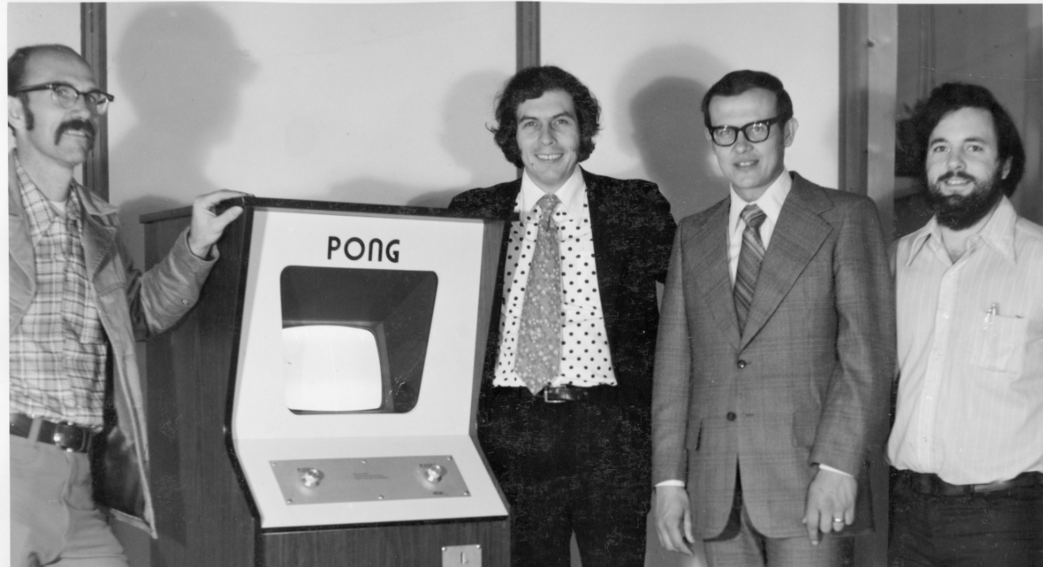
1972
1976
Notes:
1973 the first

Slide 15
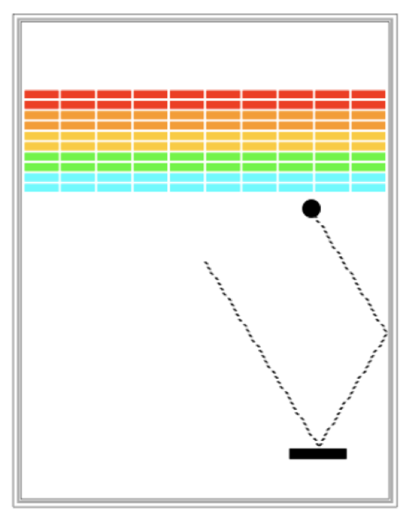
Requirements
Goal is to break all bricks
User has 3 turns
Ball in the center start moving towards bottom at random angle
Ball bounces paddle, right wall and the bricks

Slide 16
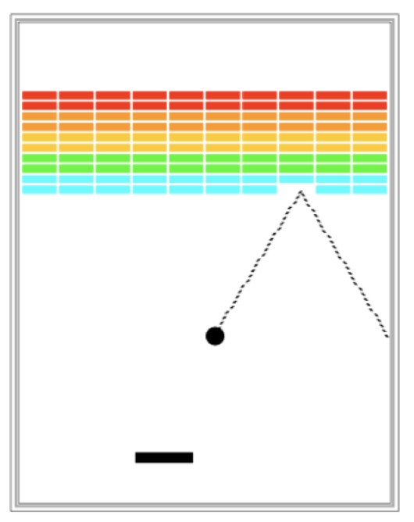
Requirements
When hit a brick, the brick disappears
Ball moves down either hitting left wall, paddle or bottom wall
The turn continues until
The ball hits the lower wall.
NEXT TURN or YOU LOOSE
The last brick is eliminated.
YOU WIN

Slide 17
Big program. Do it in parts
1
2
3

Slide 18
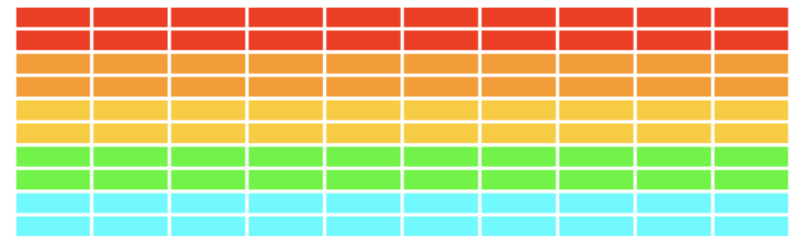
Part 1 - Creating Bricks
Number, dimensions and spacing of bricks as constants
Calculate x coordinate of the first column - so that bricks are centered
Colors of bricks - red, orange, yellow, green and cyan

Slide 19
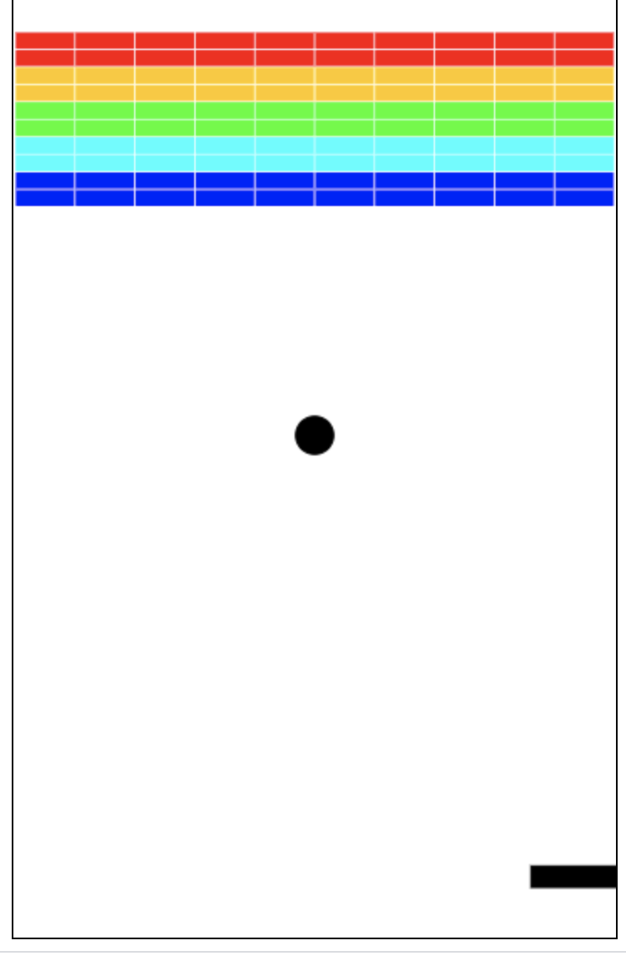
Part 2 - Add and move ball
Put filled ball at the center of the window
Coordinates of the ball is the upper left corner
Velocity of the ball - declared as variables
change_x = 10
change_y = 10
Pick random values for change in x and y
Move the ball using
canvas.move(object, change_x, charge_y)
canvas.moveto(objects, new_x, new_y)
Move the ball - Initially - ball heading downwards

Slide 20
Part 2 - Bouncing ball
Animation loop - where ball is moving
Bounce from right, left and top walls
Bottom wall - start in the middle again
Update the canvas - where bricks are removed
When bounced from top or bottom wall
Inverse change_y
When bounced from left or right wall
Inverse change_x

Slide 21
Part 3 - Add Paddle
Create Paddle - filled rectangle at a specific location
Link paddle move with mouse move
Move paddle - track x coordinate of the mouse onl
Use mouse_x = canvas.get_mouse_x()

Slide 22
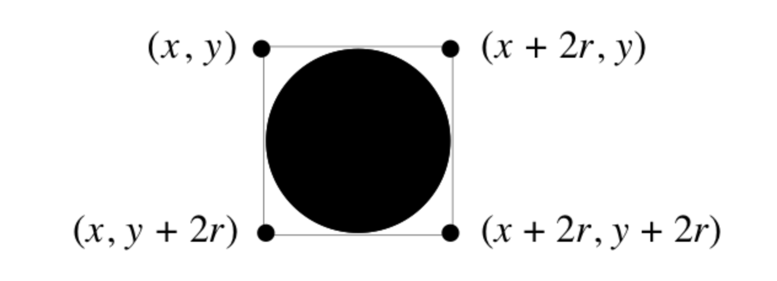
Part 4 - Check for collision
Did ball collide with another object in the window
canvas.find_overallapping (x1, y1, x2, y2) which return list of objects overalling with rectangle whose upper left is (x1, y1) and bottom right is (x2, y2)

Slide 23
Part 4 - Check for collision
Use of list
# this graphics function gets the location of the ball as a list
ball_coords = canvas.coords(ball)
# the list has four elements:
x_1 = ball_coords[0]
y_1 = ball_coords[1]
x_2 = ball_coords[2]
y_2 = ball_coords[3]
# we can then get a list of all objects in that area
colliding_list = canvas.find_overlapping(x_1, y_1, x_2, y_2)

Slide 24
Part 4 - Check for collision
Collide with a paddle
Bounce ball towards up
Collide with a brick
Bounce ball towards down
Flip change_y direction
Remove brick from the screen
canvas.delete(square) # deletes the object called square
Count the number of removed bricks
That’s how you know you hit the last brick

